Slide 1


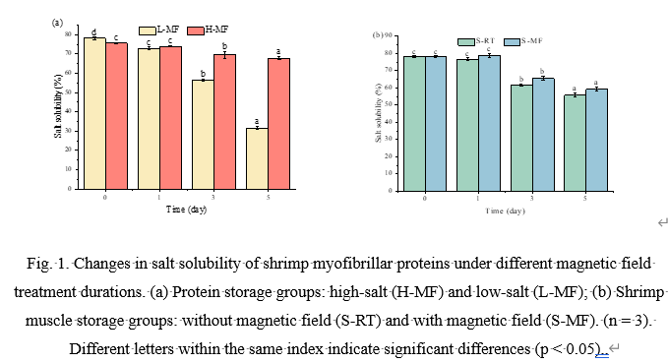
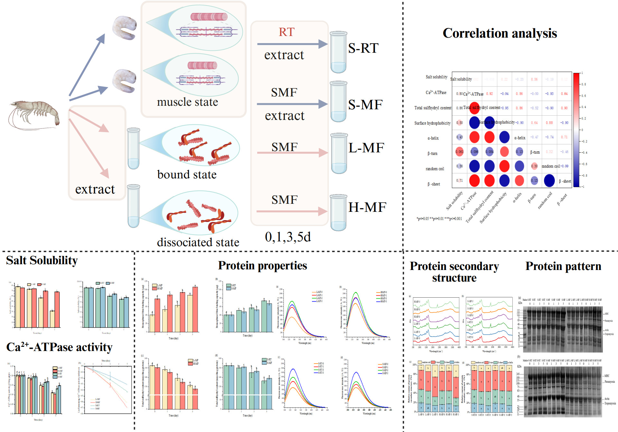
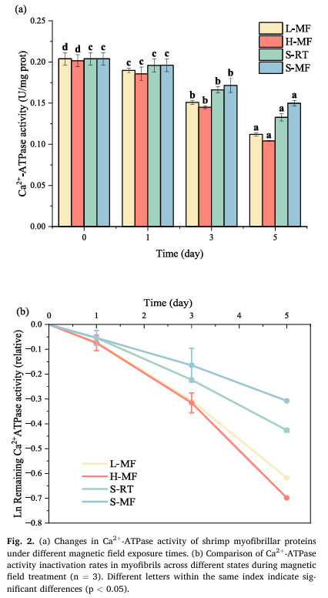
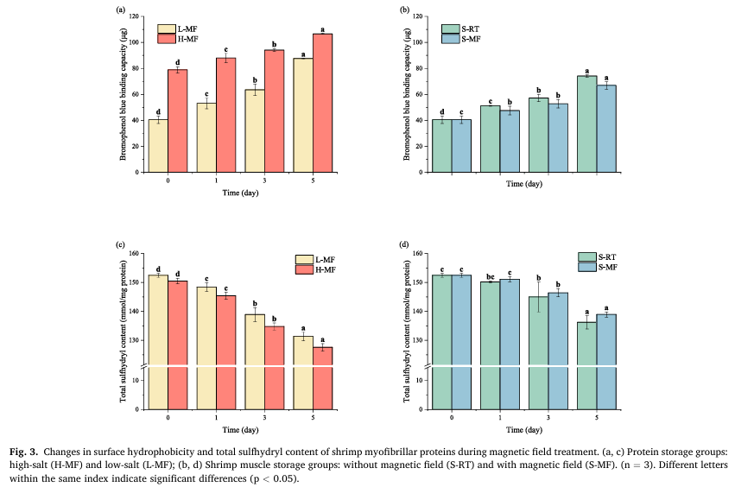
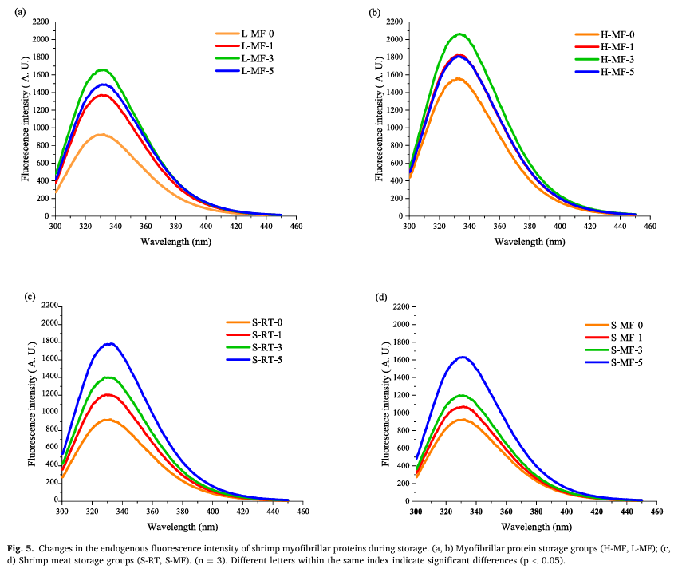
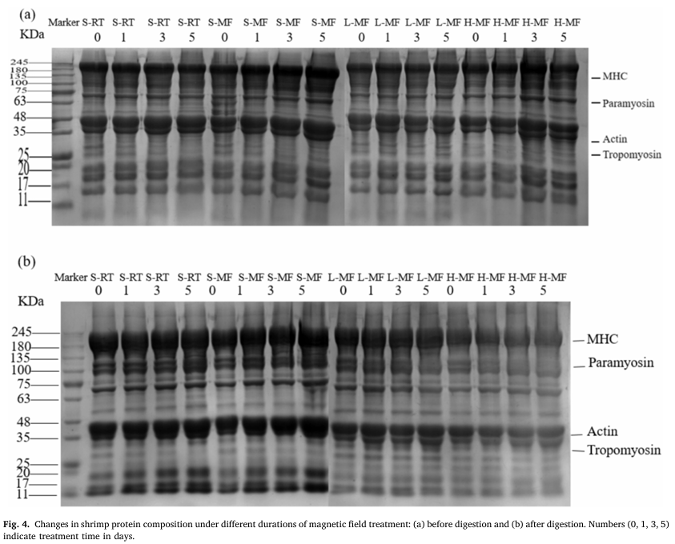
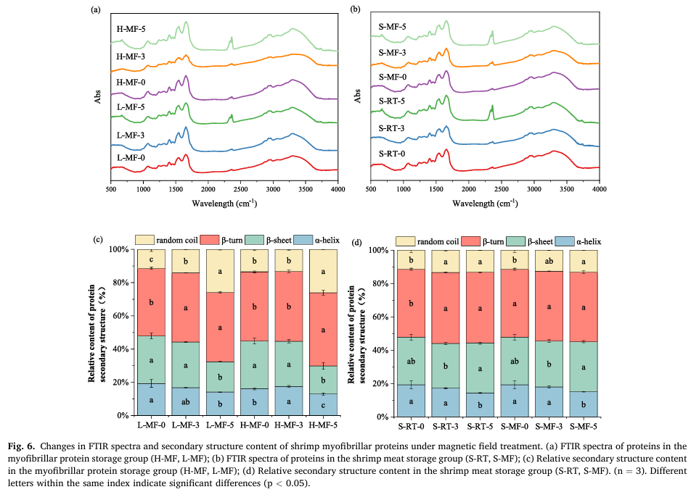
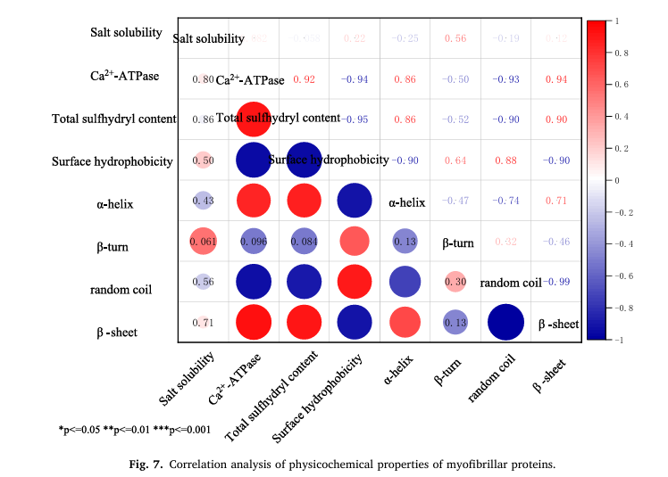
FSMILE 2025
Investigating the mechanisms behind magnetic field effects on shrimp myofibrillar protein conformation and functionality
October 04-07, 2025
@Morioka & ZOOM Cloud
Fangqi Yuan 1,2, Jingxu Zhao 1,2, Chunhong Yuan 3, Zhaohui Qiao 1,2, Wenge Yang 1,2, Yongjiang Lou 1,2, Changrong Ou 1,2,*, Huamao Wei 1,2,*
1 College of Food Science and Engineering, Ningbo University, Ningbo 315211, China
2 Zhejiang Key Laboratory of Intelligent Food Logistic and Processing, Zhejiang-Malaysia Joint Research Laboratory for Agricultural Product Processing and Nutrition, Ningbo University, Ningbo 315211, China
3 Faculty of Agriculture, Iwate University, Ueda 3-18-8, Morioka, Iwate 020-8550, Japan
International Symposium on Food Communications and Sustainable Agri-Aqua Food Systems
Connecting Primary Industries, Academia, and Society through the SDGs
Contact Information:
whm900916@nbu.edu.cn (H. Wei)
19909057790@163.com(F.Yuan)
Introduction
During cold storage, aquatic products are prone to quality deterioration due to protein denaturation, aggregation, and degradation. As a non-thermal physical preservation technology, magnetic fields can regulate protein conformation, reduce oxidation and aggregation, and thereby delay quality loss. This study focused on Penaeus vannamei to investigate the effects of a 5 mT static magnetic field under low-temperature storage on the structural and functional stability of myofibrillar proteins.
Results
Conclusions
The present study systematically revealed the structural regulation mechanism of Penaeus vannamei myofibrillar protein (MP) in different states under a 5 mT static magnetic field.
The results showed that the magnetic field significantly suppressed reactive oxygen species (ROS) generation in the intact muscle system (S-MF), maintained sulfhydryl group integrity and low surface hydrophobicity, thereby slowing down the oxidative denaturation of MP and maintaining the stability of α-helix and β-sheet structures.
Although the H-MF group increased initial salt solubility, the myosin-myosin-calmodulin complex was completely dissociated, exposing more hydrophobic and -SH sites, leading to exacerbated aggregation and degradation in subsequent stages;
The L-MF group only partially dissociated MP, maintaining its structural stability.
Comparing the results of muscle groups, the results from SDS-PAGE, surface hydrophobicity, total sulfhydryl content, FTIR, and endogenous fluorescence were mutually corroborative: the magnetic field primarily exerts a protective effect at the side chain level (–SH groups and hydrophobic groups), while its influence on the secondary structure maintained by hydrogen bonds in the main chain is limited.
This study clarifies the mechanism by which low-temperature magnetic fields affect the biochemical properties of shrimp myofibrillar proteins, providing a theoretical basis and technical references for low-temperature magnetic field synergistic preservation and protein structural-functional targeted improvement.
AIM
In this study, different protein organizational states were constructed and combined with various physicochemical and functional analyses to reveal the protective mechanisms of magnetic fields on shrimp myofibrillar proteins, providing a theoretical basis for the application of magnetic field technology in aquatic product preservation.
Method
In this study, three myofibrillar protein states were set up: bound state (L-MF, Tris-HCl buffer with 0.1 M NaCl), dissociated state (H-MF, Tris-HCl buffer with 0.6 M NaCl), and muscle-associated state (S-MF, S-RT). All samples were exposed to a static magnetic field of 5 mT throughout the refrigeration period. The muscle without any treatment (control group, S-RT) was stored at 4 °C in the absence of magnetic field exposure. The salt solubility, Ca²⁺-ATPase activity, surface hydrophobicity, total sulfhydryl content, protein profiles (SDS-PAGE), endogenous fluorescence spectra, and secondary structure to systematically reveal the degradation mechanism of shrimp myofibrillar proteins under magnetic field. In the S-MF and S-RT groups, myofibrillar proteins were extracted using the same method as for the L-MF group, and the samples were then stored at 4 °C. Relevant parameters were measured at designated time points during storage (days 0, 1, 3, and 5).
References
Cai, L., Li, D., Dong, Z., Cao, A., Lin, H., & Li, J. (2016). Change regularity of the characteristics of Maillard reaction products derived from xylose and Chinese shrimp waste hydrolysates. Lwt, 65, 908-916.
Wei, H., Tian, Y., Yamashita, T., Ishimura, G., Sasaki, K., Niu, Y., & Yuan, C. (2020). Effects of thawing methods on the biochemical properties and microstructure of pre-rigor frozen scallop striated adductor muscle. Food Chemistry, 319.
……

